Slide 1
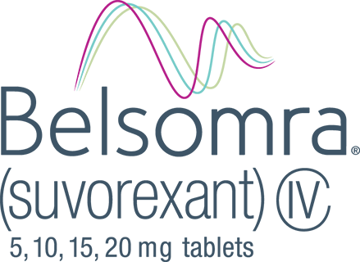
BELSOMRA® HCP and Consumer Marketing Mix Analysis (Jan’22 – Dec’22)
Impact Assessment & Investment Optimization | Human Health Digital, Data and Analytics
June 2023

Slide 2
Guidelines for Sharing ROIs
The internal ROIs provided by the Impact Assessment & Investment Optimization team are calculated using proprietary and sensitive financial data. Because of this, HHDDA¹ and Merck Finance² recommend the following guidelines for sharing ROIs:
For strategic partners who assist in making marketing investment decisions such as Team Frontiers, please only share pre-tax ROIs. Post-tax ROIs are for internal use only.
For external marketing vendors who are contracted to provide a marketing program (i.e., PatientPoint, Doximity, Medscape, etc.), absolutely no ROIs can be shared. If a vendor asks, please direct them to HHDDA¹ .
As a professional courtesy, depending on the need, HHDDA¹ will inform internal business partners and get their approval prior to sharing ROIs with other Merck teams.
Thank you for your adherence to these guidelines. Please contact HHDDA¹ with any questions.
¹HHDDA Impact Assessment & Investment Optimization Team: Milind Bhamawat / Senthil Murugan, Blythe Bealer and Tracie Quiggle.
²Merck Finance: Brian Loftus, Ken Lee and Andrea Gray

Slide 3
Executive Summary
Consumer & Point of Care:
In 2022, Consumer digital promotion with a pre-tax spend of $1.7M contributed ~4% ($6.3M) to total BELSOMRA® pre-tax sales with an ROI of 3.7:1. (Prior year results were ~3.7% of total BELSOMRA® sales with spend of $1.8M and 2.6:1 ROI)
Paid Search drove most of the digital impact (~2.6% & $4.1M) and was highly cost effective.
Overall Consumer digital promotion drove ~10K incremental NRxs
Point of Care contributed ~12.2% ($18.6M) to total BELSOMRA® sales with a pre-tax spend of $4.9M and ROI of 3.8:1.
Conclusions/Recommendations:
Each of the HCC channels (paid search, social and POC) have improved in both % contribution to sales and ROI while keeping spend relatively the same; continued spend in each channel is recommended
Reporting period – Jan22-Dec22
Green color numbers indicate Incremental Revenue

Slide 4
Executive Summary
HCP:
HCP digital promotion, with a pre-tax spend of $1.3M, contributed 2.5% ($3.9M) to total BELSOMRA® pre-tax sales with an ROI of 3.1:1. (Prior year results were 3.8% contribution, with spend of $2.4M and 1.9:1 ROI).
Veeva email contributed an additional, estimated 2.1% ($3.4M) to total sales. (Prior year was 1.8% / $2.2M)
HQ Email and Medscape drive most of the impact and are cost effective.
Epocrates ROI continues to be below breakeven.
Overall HCP digital promotion drove ~6K incremental NRxs and Veeva email generated ~5K incremental NRxs
One HCP POC program (PatientPoint Access) also ran in 2022 with pre-tax spend of $195K, generating a 2.7:1 pre-tax ROI and a 0.3% contribution to sales ($528K in pre-tax revenue).
Conclusions/Recommendations:
Both Doximity and Epocrates ROIs came in around breakeven. Consider a CPE reduction in both to improve ROI.
Reporting period: Jan22-Dec22
Green color numbers indicate Incremental Revenue

Slide 5
BELSOMRA® Consumer Marketing Mix Analysis (Jan’22 – Dec’22)
Impact Assessment & Investment Optimization | Human Health Digital, Data and Analytics
June 2023

Slide 6














Marketing Mix Modeling
Marketing mix modeling analyzes all promotion activities and control market events, seasonality and
other non-promo factors to deliver more reliable, macro-level results. It also estimates the response curves per media type to inform more optimal allocation of resources for national media planning
Holistic method for estimating consumer media channel contributions to sales…
TV
HCC Display
HCC Video
HCC Streaming Video
HCC Paid Search
Social
Print
Radio
HCC Email
…while controlling for other important influences in the market, including HCP promotion.
Carryover
Market Growth
SF Calls & Samples
HCP Display
HCP Paid Search
MMF
Seasonality
Market Events
(1) Each type of promotion is captured via a metric specific to that type based on available data and the purpose of the activity.
(2) The “half-life” (length of time for half of the influence to be realized) for each promotion type is estimated in the modeling process.
(3) ROI is given by net present value (pre-tax) divided by pre-tax cost.

Slide 7
Digital Consumer Tactics’ Activities
$1.8M (pre-tax) on Social, Paid Search and Display in 2022
Impressions were used as a metric for Social while Clicks were used for Paid Search
There was no spend on HCC Display in 2022
There has been an increase in spend for Paid Search whereas there has been a slight decrease in spend for Social.
*2021 spend was based on Apr’21 - Mar’22
Spend, Revenue and ROI numbers are pre-tax numbers.
Paid Search included Google & Bing , Social was only Facebook

Slide 8
In 2022, Consumer digital promotion with a pre-tax spend of $1.7M contributed ~4% ($6.3M) to total BELSOMRA® pre-tax sales with an ROI of 3.7:1
Considerations –
Paid Search drove most of the digital impact and was highly cost effective
Overall consumer digital promotion drove ~10K incremental NRxs between Jan’22 and Dec’22
Sales impact calculated in part using data from IQVIA and converted to 3yr NPV using value from US Financial Planning & Analysis for 2023 Annual Budget

Slide 9
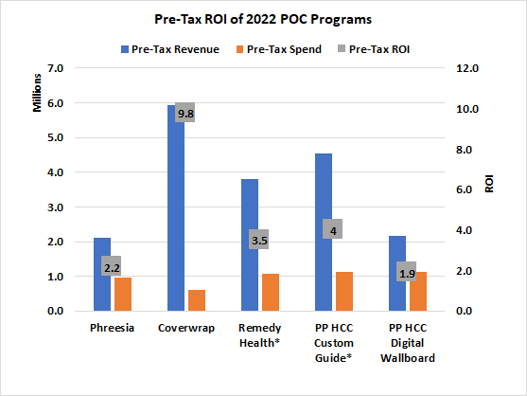
In 2022, HCC Point of Care with a pre-tax spend of $4.9M contributed 12.2% ($18.5M) to total BELSOMRA®
pre-tax sales with an ROI of 3.8:1
Considerations –
Patient Point Custom Guide and CoverWrap Communications drive most of the impact and are cost effective.
All revenue and ROI estimates are based on results from independent analyses
One HCP POC program (PatientPoint Access) also ran in 2022 with a pre-tax spend of $195K, generating a 2.7:1 pre-tax ROI and a 0.3% contribution to sales.
*PP Custom and RH 2022 measurements are in progress, % contribution and ROI estimated based on prior measurements and current spend.
Sales impact calculated in part using data from IQVIA and converted to 3yr NPV using value from US Financial Planning & Analysis for 2023 Annual Budget

Slide 10
2022 ROI shows positive return for all digital channels. Total Spend remains almost the same and the %contribution increased by 17% from last year, while the overall ROI increased ~23%
 | 2021* |  |  |  |  |  | 2022**
Vendor | Pre-Tax Spend | # Activity | Cost / Activity | % Contrib. to Sales | Pre-Tax Incr. Revenue | Pre-Tax ROI | Pre-Tax Spend | # Activity | Cost / Activity | % Contrib. to Sales | Pre-Tax Incr. Revenue | Pre-Tax ROI
Display | $ 0.1 M | 9,786,364 | $0.013 | 0.0% | $ 0.0 M | 0.2
Paid Search | $ 0.4 M | 198,745 | $2.118 | 1.9% | $ 2.4 M | 5.7 | $ 0.7 M | 242,240 | $2.704 | 2.6% | $4.1 M | 6.2
Social | $ 1.2 M | 150,501,863 | $0.008 | 1.7% | $ 2.1 M | 1.8 | $ 01.1 M | 98,369,252 | $0.011 | 1.4% | $2.3 M | 2.1
Total (measured) | $ 1.8 M |  |  | 3.7% | $ 4.6 M | 2.6 | $ 1.7 M |  |  | 4.0% | $ 6.3 M | 3.7
POC | $ 4.0 M |  | 10.1% | $ 12.7 M | 3.1 | $ 4.9 M |  | 12.2% | $ 18.6 M | 3.8
Total (HCC + POC) | $ 5.8 M |  | 13.8% | $ 17.3 M | 3.0 | $ 6.7 M |  | 16.2% | $ 24.9 M | 3.7
*2022 Impact is based on Jan’22 - Dec’22; **2021 Impact is based on Apr’21 – Mar’22
Spend, Revenue and ROI numbers are pre-tax numbers.
Both time periods use 3yr NPV S Financial Planning & Analysis for 2023 Annual Budget Planning

Slide 11
BELSOMRA® HCP Marketing Mix Analysis
Impact Assessment & Investment Optimization | Human Health Digital, Data and Analytics
June 2023

Slide 12


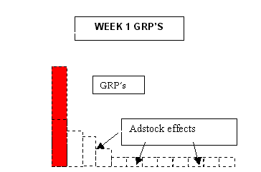

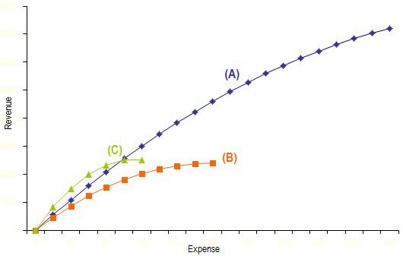
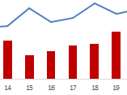
marketing mix modeling
Marketing mix is a holistic method for estimating promotion contributions to sales while controlling for other important influences to inform more optimal resource allocation
Input Metrics¹: Promo Activity
Units of Analysis: HCP/Month
Lagged Effects: Adstock
deliveries, engagements, clicks
while controlling for:
Time series for each HCP
Promotion/media are “adstocked” to capture effects in future weeks²
HQ, Email
Mobile &
Web Alerts
Edetail & Banners
Digital Display
Field & US3C Activity
Carryover
Modeling Approach
Outcome Metrics
Limitations & Appropriate Use
Leverages peaks/valleys in sales and promotion across time and HCP to measure the extent to which sales go up when a given promotion activity goes up and vice versa.
Net Present value, ROI³, response curves for optimization
This approach measures the association between activity and sales. It does not provide conclusive evidence of causality. Results are most appropriate for informing relative investment trade-off decisions.
(1) Each type of promotion is captured via a metric specific to that type based on available data and the purpose of the activity.
(2) The “half-life” (length of time for half of the influence to be realized) for each promotion type is estimated in the modeling process.
(3) ROI is given by net present value (pre-tax) divided by pre-tax cost.

Slide 13
HCP Digital Tactics’ Monthly Activities Trend
Engagements are counted once per unique tactic per month for each HCP
Deep Intent engagements were too low to measure.
Field and HQ Email engagements peaked in April and had a declining trend after that period.

Slide 14
HCP Digital Activity Summary
Engagements are counted once per unique tactic per month for each HCP
Medscape’s engagement rate is inflated because all alerts delivered “in-article” count as an engagement
Spend has decreased significantly across all the 3PV
Known data issues that have been accounted for:
IOS15 upgrade (Sep 2021): increases opens/engagement counts with false opens
HQ Email data error (10/14/2022): causes duplicate and/or missing deliveries, opens and clicks
HQ Email costs include rental and execution cost but exclude DP and creative costs

Slide 15
In 2022*, HCP digital promotion, with a pre-tax spend of $1.3M, contributed 2.5% ($3.9M) to total BELSOMRA® pre-tax sales with an ROI of 3.1:1. Veeva email contributed an additional, estimated 2.1% ($3.4M) to total sales.
Medscape and HQ Email drove most of the impact.
Epocrates ROI continues to be below break even.
We couldn’t measure Deep Intent due to lower engagement volumes
Overall HCP digital promotion drove nearly 12K incremental NRxs in 2022
Sales impact calculated in part using data from IQVIA and converted to 3yr NPV using value from US Financial Planning & Analysis for 2023 Annual Budget Planning
2022 Impact is based on Jan22-Dec22

Slide 16
2022 ROI shows positive return for all vendors except Epocrates. Total spend decreased by half and the % contribution decreased by 35% while the overall ROI increased by 60%.
Deep Intent had $0 spend in 2021 while engagement volumes in 2022 were too low to measure.
Spend, Revenue and ROI numbers are a pre-tax numbers.
Both time periods use 3yr NPV S Financial Planning & Analysis for 2023 Annual Budget Planning

Slide 17
APPENDIX

Slide 18
Belsomra® NRx went from a slightly negative trend in 2021 to a positive trend in 2022, resulting in 9% YoY growth.
Key market events in 2022:
DAYVIGO removed their field sales force
QUVIVIQ became 3rd entrant in DORA class (FDA approval Jan22), investing heavily in HCC branded (celebrity) campaigns which may have helped drive awareness in the DORA class (starting in May22)

Slide 19
Belsomra® HCP Digital CPE Thresholds (Pre-Tax)
For example, to increase the Epocrates ROI from current state(0.9) to a 2:1 ROI, CPE should decrease to $42.
This table estimates the maximum cost per engagement for HCP digital channels. All data shown is pre-tax. CPE at the current ROI level are highlighted in yellow, the next level in green.
Please note:
deployed spend is used for this analysis – not contract spend
Engagements are counted once per unique tactic per month for each HCP
ROI estimates are on pre-tax scale (pre-tax revenue/pre-tax cost) where pre-tax revenue is based on a 3yr NPV from US Financial Planning & Analysis for 2023 Annual Budget Planning. The 3-yr NPV assumes 2022 promotion investment impact on revenue in 2022, 2023, and 2024.

Slide 20
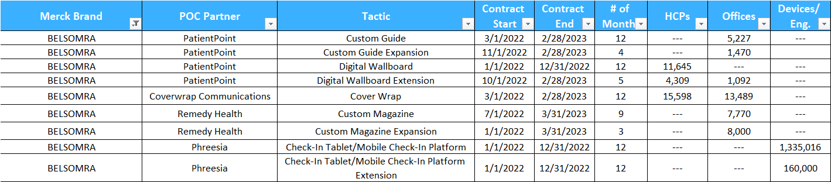
HCC POC Program Detail
Source: Team Frontiers (Will Kissell)

